Slide 1
2014 – 2015 Rebecca Caudill Book Award
Notes:
This template can be used as a starter file for a photo album.

Slide 2
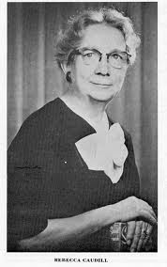
Rebecca caudill
Introducing

Slide 3
- try new books - reading for pleasure - Reading and writing - Prizes
Why?

Slide 4
The Prizes
3 books - Homework Pass (and vote for the state award!)
6 books - $5 Gift Certificate to Scholastic Book Fair
10 books - Special Lunch!
15 books – Mystery Prize
Entire List - $10 Gift Card to Target
*Each book read will also increase the chances of winning the grand prize: $20 Target Gift Card!

Slide 5
How?
Read and Report!

Slide 6
Create a Book Trailer Using Animoto
Fill out a form…
or
How?
Reading and Reporting

Slide 7
When?
Voting
Our program

Slide 8
Questions?

